Slide 1

Update May, 2018

Slide 2
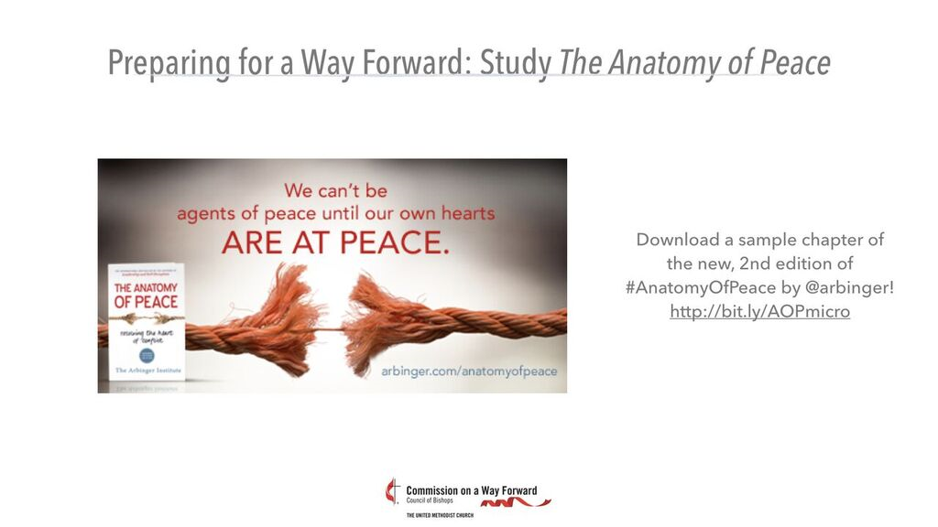

Slide 3
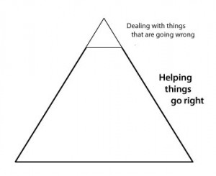

Slide 4
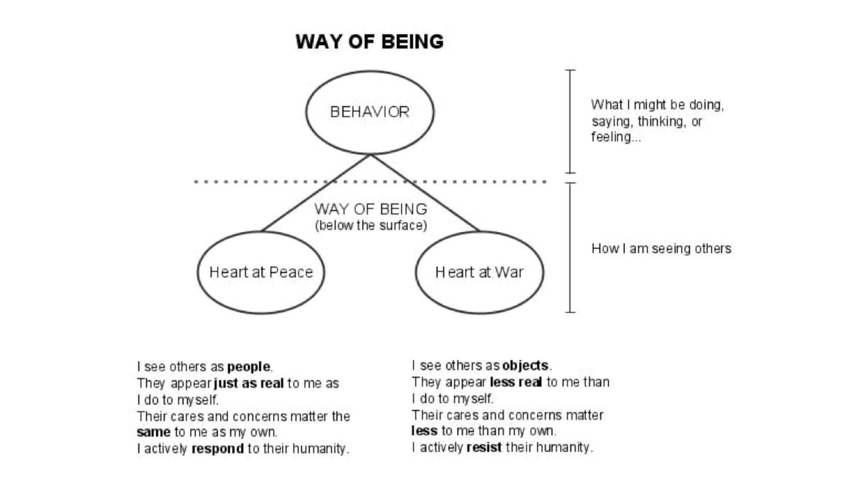

Slide 5

SOME ISSUES
BEFORE US
Disagreement about Par. 161.G: Marriage, Ordination, and ministry with LGBTQ persons.
People leaving our churches or threatening to leave
The need to focus on mission and vitality

Slide 6
SOME ISSUES
BEFORE US
Disagreement about P 161.G
Same Sex Marriage
Ordination of self-avowed practicing homosexual persons

Slide 7
SOME ISSUES
BEFORE US
Our ability to reach LGBTQ persons and their allies and include them in the life of the church
People leaving our churches
  progressive people
  traditional people

Slide 8
THE IMPORTANCE
OF DIFFERENCES
“We cannot solve our problems with the same thinking we used to create them.”
Albert Einstein

Slide 9
THE IMPORTANCE
OF DIFFERENCES
“No one sews a piece of new, unshrunk cloth on old clothes…”
“No one pours new wine into old wineskins…”

Slide 10
A DIFFERENT KIND
OF REPORT
Commission on A Way Forward – not a caucus, constituency, agency or committee
32 People
All Jurisdictions
Men and Women
9 Nations
15 States
Straight and Gay
Laity, elders, deacons, bishops
Full span of generations (including unborn)
Across the ideological spectrum

Slide 11
A DIFFERENT KIND
OF REPORT
Does not come from like-minded people
Is not the product of debate and parliamentary procedure
Angered and upset but never left the table or stopped contributing
Is a product of conversation, study, prayer, listening, transparency, and trust

Slide 12
NO PERFECT SOLUTIONS
A UMC in over 95% of US counties
Blue and Red States
African nations where homosexuality is illegal

Slide 13
NO PERFECT SOLUTIONS
Western Europe and Eastern Europe
Evolving views in the Philippines
Generations that have few issues
There is no definitive answer, except for those people who have their own definitive answer.

Slide 14
CHOOSING
Connected and unified as possible
Agile, responsive and contextual
as possible
Live in and address the widest global and cultural mission field as possible

Slide 15
FAMILIAR POLARITIES
    A polarity is two equal truths that cannot be easily held at the same time.
LAW GRACE
WORKS FAITH

Slide 16
UNDERSTANDING POLARITIES
A polarity is two equal truths that cannot easily be held together at the same time.
CENTRALIZED DECENTRALIZED

Slide 17

WHICH WAY TO LEAN?
D
E
C
E
N
T
R
A
L
I
Z
E
D
C
E
N
T
R
A
L
I
Z
E
D

Slide 18
UNITY AND CONTEXTUALITY
Unity [Sameness] | [+] Shared belief and practice Agreement Clarity | [+] Shared identity and purpose Inclusive Responsive | Contextuality [Difference]
 | Exclusive Rigid [-] | Lack of clarity Lack of boundaries [-]

Slide 19
THE CHOICES FOR
GC 2019
Which side of the polarity must the UMC now lean into in order to live into its next guiding story?

Slide 20
THE CHOICES FOR
GC 2019
Which mission must the church now choose to pursue?
    The Public Mission
    The Private Mission
(Who are you choosing for?)

Slide 21
THREE SKETCHES
One Church
Connectional Conference
Traditional

Slide 22
ONE CHURCH PLAN

Slide 23
ONE CHURCH PLAN
Recognizes the diverse theological and scriptural understandings of our global church
Provides generous unity for conferences, churches, and pastors

Slide 24
ONE CHURCH PLAN
Removes the restrictive language from our current Book of Discipline.
Maintains the current structure of the denomination

Slide 25
ONE CHURCH PLAN
Removes the restrictive language from our current Book of Discipline

Slide 26
ONE CHURCH PLAN
Does not require any annual conference, bishop, congregation, or pastor to act contrary to their convictions
Allows congregations and pastors greater freedom to reach new people

Slide 27
CONNECTIONAL CONFERENCE PLAN

Slide 28
CONNECTIONAL CONFERENCE PLAN
Creates three values-based connectional conferences: traditional, unity, progressive

Slide 29
CONNECTIONAL CONFERENCE PLAN
Traditional – no one can
Unity – all can, no one must; some will, some won’t,
Progressive – all shall

Slide 30
CONNECTIONAL CONFERENCE PLAN
Allows for a Book of Discipline within each connectional conference

Slide 31
CONNECTIONAL CONFERENCE PLAN
Current central conferences have the choice of becoming their own connectional conference
Council of Bishops is focused on shared learning and ecumenical relationships

Slide 32
CONNECTIONAL CONFERENCE PLAN
Episcopal oversight, accountability, elections, assignments, and funding occur within the College of Bishops of each connectional conference

Slide 33
CONNECTIONAL CONFERENCE PLAN
Jurisdictional Conferences choose their connectional conference
Local churches who desire to join a branch that is different from their annual conference could vote to join another annual conference

Slide 34
TRADITIONAL
CHURCH PLAN

Slide 35
TRADITIONAL
CHURCH PLAN
Strengthens the current language of the Book of Discipline concerning human sexuality for greater clarity

Slide 36
TRADITIONAL
CHURCH PLAN
Streamlines the process to enforce penalties for violations of the Book of Discipline related to marriage and ordination of self-avowed practicing homosexual persons

Slide 37
TRADITIONAL
CHURCH PLAN
Maintains the current structure of the church
Continues the current relationships between the church and all general agencies and commissions

Slide 38
Who Will the UMC Be?
In what form of faith community?
With what unity?
Seeking to do ministry with whom?

Slide 39
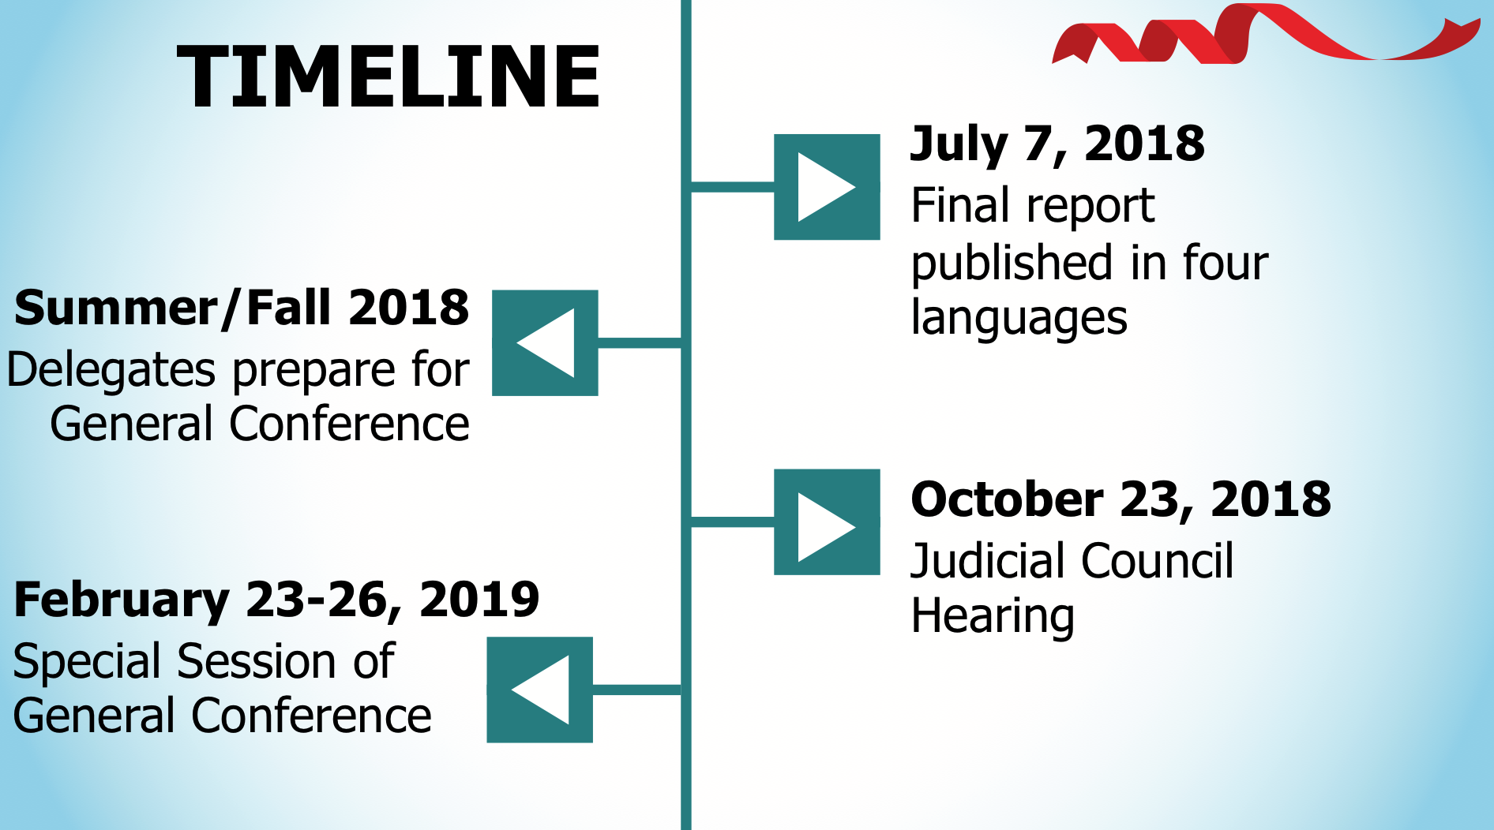

Slide 40
Judicial Council Process
Council of Bishops ask for a Declaratory Decision on All Plans
Briefs written on constitutionality by those who signed plans
Amicus Curiae briefs submitted for or against constitutionality of plans

Slide 41
Judicial Council Process
Response briefs written by all parties
Judicial Council hearing – oral arguments
Judicial Council rules on constitutionality of plans

Slide 42
Why Is This Helpful?
Plans could be voted on by GC delegates and later found to be unconstitutional
Problematic issues can be identified
Delegates can amend, substitute or delete problematic provisions of plans

Slide 43
Pension Impacts
of Commission Proposals

Slide 44
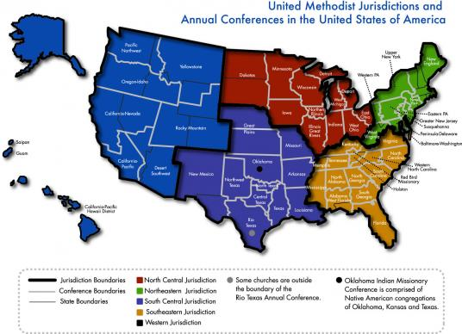
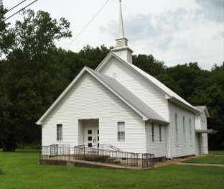
Annual Conferences Responsible
Annual conferences are the “plan sponsors” of the Wespath pension plans, and are legally responsible for paying the benefits promised.
Image Source: umc.org—United Methodist Communications
Local churches contribute to the pension plans through and as directed by the annual conferences.

Slide 45
Long Tail of Pension Payments
With No New Entrants
Annual conferences guarantee
the long-term liability

Slide 46
Resources
Baltimore-Washington Annual Conference Presentation
Faultlines Collection – Abingdon Press

Slide 48
Love Languages
  Affirming Words
Receiving Gifts
Quality Time
  Acts of Service
  Physical Touch

Slide 49
UMC Love Languages
Evangelism
Worship and Discipleship
Compassion
Justice
Community

Slide 50
The Council of Bishops (COB) has voted by an overwhelming majority to share the work done by the Commission on a Way Forward on the three plans and to recommend the One Church Plan.
The One Church Plan will be placed before the General Conference for legislative action.

Slide 51
To honor the work of the commission, and in service to the delegates to the 2019 Special Session of the General Conference, the COB will also provide supplemental materials that include a historical narrative with disciplinary implications related to the connectional conference plan and the traditionalist plan.

Slide 52
The recommendation adopted by the COB reflects the wide diversity of theological perspectives and the global nature of The United Methodist Church as the best way forward for our future as a denomination.

Slide 53


Slide 54
THANK YOU

