Slide 1
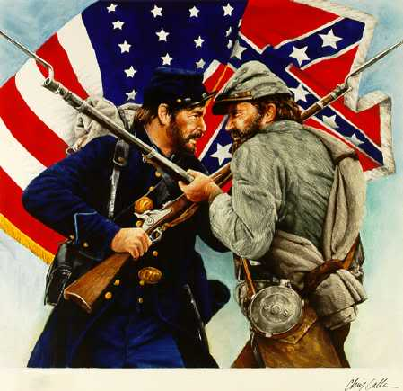
American Civil War Symbols and Monuments
Data from:
Whose Heritage: Public Symbols of the Confederacy
by
The Southern Poverty Law Center
Presented by Debra J. Mumford

Slide 2
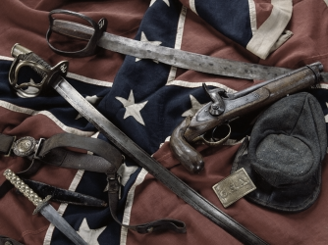
American Civil War
Four year battle - 1861 to 1865
Fought primarily over the issue of slavery
War began after seven states seceded from the Union

Slide 3
American Civil War
Reasons for succession
The Republican Party of Lincoln wanted to prevent the spread of slavery as America expanded West.
Stopping expansion would put slavery on a path to eventual extinction.
Southern states believed stopping expansion of slavery was an infringement of their Constitutional rights.
Emancipation of slaves would destroy the South’s economy.

Slide 4
American Civil War
Southern states believed they had the right to secede from the Union at any time.
Northern states believe the founding fathers set up a perpetual Union that made succession illegal.

Slide 5
American Civil War
Seven states succeeded after Lincoln’s inauguration, formed Confederate States of America
South Carolina
Mississippi
Florida
Alabama
Georgia
Louisiana
Texas

Slide 6
American Civil War
New Confederate government established February 1861
Considered illegal by the government of the United States
Four slave states joined Confederacy after start of war
Virginia
Arkansas
Tennessee
North Carolina

Slide 7
American Civil War
The Battle of Fort Sumter in Charleston, South Carolina – April 12, 1861
The Beginning https://www.youtube.com/watch?v=t9dNDWzsZTI
After South Carolina succeeded from the Union in December 1860, Federal troops from the North seized control of Fort Sumter
This initiated a standoff between Federal government and state militias that had succeeded
Lincoln announced plans to resupply the fort, helped Federal forces maintain control
General PGT Beauregard of the Confederate troops bombed the fort
Confederate troops regained control of the fort and occupied it throughout four years of the Civil War

Slide 8
American Civil War
The Confederacy accepted Missouri and Kentucky as members
Neither officially declared secession
Neither state controlled by Confederate forces;

Slide 9
American Civil War
The term “States Rights” was coined by Mississippi Senator Jefferson Davis
Means of advancing slave state interest through federal authority

Slide 10
American Civil War
Between 620,000 and 750,000 soldiers were killed during the war
More people died in Civil War than in all other wars combined
The infrastructure of the South was destroyed including railroad, houses, and mills
The Confederacy Collapsed

Slide 11
American Civil War
Richmond, Virginia
Capital of the Confederacy

Slide 12
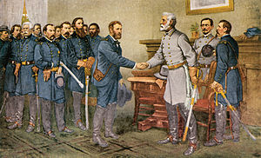
The Civil War officially ended when General Robert E. Lee surrendered to General Ulysses S. Grant at the Battle of Appomattox in Virginia.

Slide 13
Notes:
In June 2015 Dylann Roof assassinated 9 African American parishioners during a bible study at the Bethel AME Church in Charelston, SC. When this picture was discovered on line of him with this flag, he ignited a movement to remove confederate symbols and monuments from public spaces. Had wanted to start a race war.

Slide 14
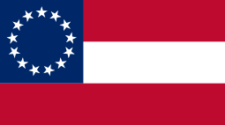
American Civil War Monuments and Symbols
Notes:
Flag represents 13 states though there were on 11 official states as part of the confederacy.

Slide 15
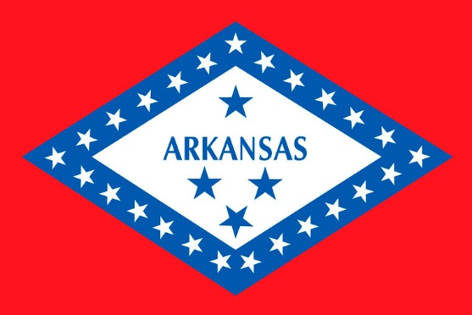
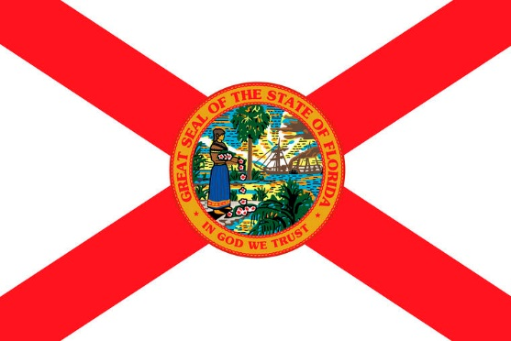
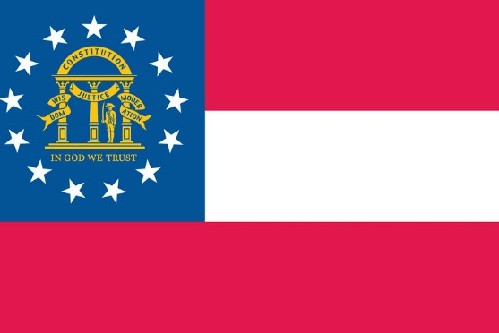
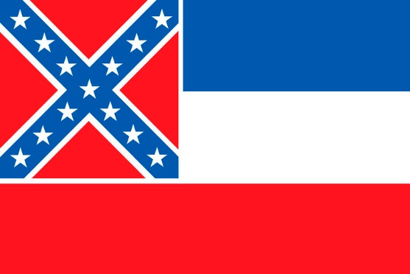
Alabama
Arkansas
Florida
Georgia
Mississippi
Notes:
These five states were part of the Confederacy

Slide 16
Notes:
Confederate flag on display at anti-immigration rally in Little Rock in 1959. Central High School was integrated in 1957.

Slide 17
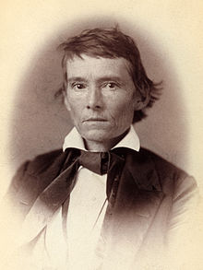
American Civil War
Some claim war was about states rights
Per Vice President of Confederacy:
“Our new government is founded upon … the great truth that the negro is not equal to the white man; that slavery subordination to the superior race is his natural and normal condition,”
- Alexander H. Stephens
Vice President Confederacy 1861
“Cornerstone speech.”

Slide 18
American Civil War Monuments and Symbols
718 monuments and statues,
nearly 300 of which are in Georgia, Virginia or North Carolina
109 public schools
named for Robert E. Lee, Jefferson Davis or other Confederate icons
80 counties and cities named for Confederates
9 official Confederate holidays in six states10 U.S. military bases named for Confederates.

Slide 19
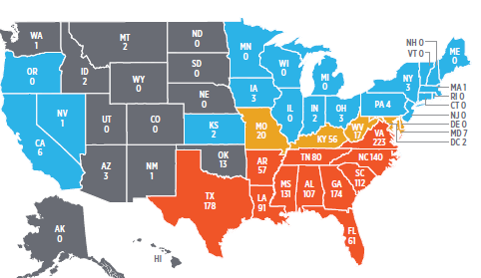
States with Most Monuments and Symbols
Virginia 223
Texas 178
Georgia 174
North Carolina140
Mississippi 131
South Carolina 112
Alabama 107
Louisiana 91
Tennessee 80
Florida 61

Slide 22
Notes:
Stone Mountain Georgia. Largest high relief sculpture in the world. Jefferson Davis, Robert E. Lee, Stonewall Jackson. 400 feet above ground, covers 3 acres of ground. Association who oversaw the work, closely affiliated with the Klan. Site of 1915 rebirth of the KKK.

Slide 23
Jefferson Davis
President of the Confederacy
1861-1865
Kentucky State Capital
Frankfort, Kentucky

Slide 24
Questions for Discussion
What history needs to be taught in your church/district?
Might your church become involved in the movement to remove monuments from public spaces? If so, how?

Slide 25
Video on race
Race: The Power of an Illusion
http://newsreel.org/video/RACE-THE-POWER-OF-AN-ILLUSION
Southern Poverty Law Centers Report on Confederate Monuments and Symbols
Whose Heritage: Public Symbols of the Confederacy
https://www.splcenter.org/sites/default/files/whoseheritage_splc.pdf

